Slide 1


Metadata,Ontologies, and the Semantic Web
http://www.datascience4all.org
Introduction to Computational Thinking and Data Science
Yolanda Gil
University of Southern California
gil@isi.edu
CC-BY
Attribution
ACI-1355475
Last Updated:
September 2016

Slide 2
Intended Audience
Designed for students with no programming background who want to have literacy in data and computing to better approach data science projects
Computational thinking: a new way to approach problems through computing
Abstraction, decomposition, modularity,…
Data science: a cross-disciplinary approach to solving data-rich problems
Machine learning, large-scale computing, semantic metadata, workflows,…

Slide 3

These materials are released under a CC-BY License
https://creativecommons.org/licenses/by/2.0/
You are free to:
Share — copy and redistribute the material in any medium or format
Adapt — remix, transform, and build upon the material
for any purpose, even commercially.
The licensor cannot revoke these freedoms as long as you follow the license terms.
Under the following terms:
Attribution — You must give appropriate credit, provide a link to the license,
and indicate if changes were made. You may do so in any reasonable manner,
but not in any way that suggests the licensor endorses you or your use.
Artwork taken from other sources is acknowledged where it appears.
Artwork that is not acknowledged is by the author.
Please credit as: Gil, Yolanda (Ed.) Introduction to Computational Thinking and Data Science. Available from http://www.datascience4all.org
If you use an individual slide, please place the following at the bottom: “Credit: http://www.datascience4all.org/”
As editors of these materials, we welcome your feedback and contributions.

Slide 4
Acknowledgments
ACI-1355475
These course training materials were originally developed and edited by Yolanda Gil (USC) with support from the National Science Foundation with award ACI-1355475
They are made available as part of http://www.datascience4all.org
The course materials benefitted from feedback from many students at USC and student interns, particularly Taylor Alarcon (Brown University), Alyssa Deng (Carnegie Mellon University), and Kate Musen (Swarthmore College)
We welcome new contributions and suggestions

Slide 5
Metadata Topics
Semantic metadata
Ontologies
The Semantic Web

Slide 6
I. Semantic Metadata
Introduction to Computational Thinking and Data Science
Yolanda Gil
gil@isi.edu
Fall 2016

Slide 7
Semantic Metadata
Metadata
A basic introduction to knowledge representation
Knowledge bases and reasoning
Frame systems
Examples of frame systems
Representing metadata

Slide 8
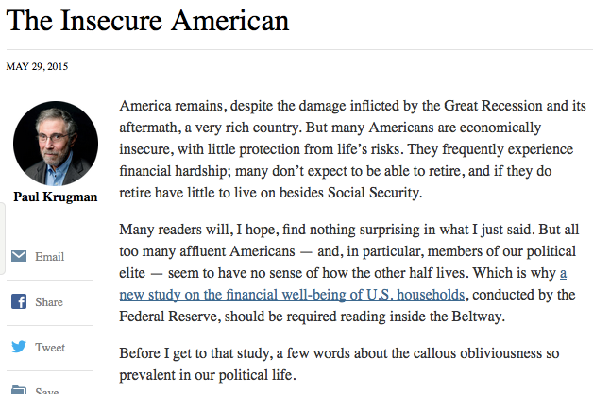
Metadata versus Data
Publisher: New York Times
Publication date: May 29, 2015
Author: Paul Krugman
Title: The Insecure American

Slide 9
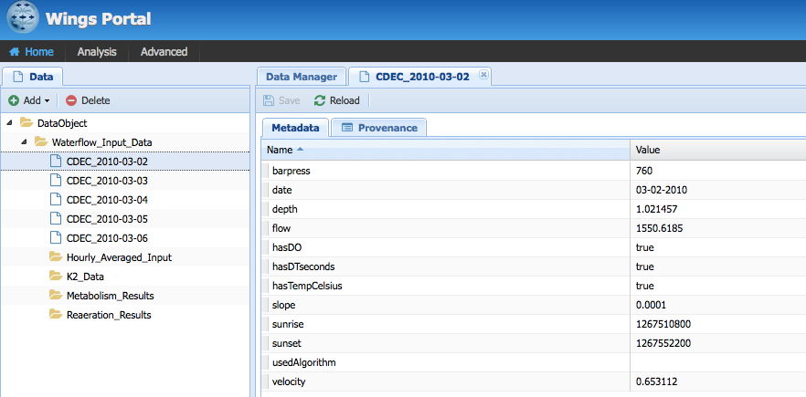
Data vs Metadata

Slide 10
Metadata

Slide 11
What is Metadata
Metadata is information that provides context key to understand what the data represents
Metadata is typically
Manually provided
Often missing
Metadata can be automatically captured
By a sensor or instrument
By a workflow system

Slide 12
Types of Metadata
Descriptive metadata: Location, collection frequency, object (rock, patient), etc…
Data characteristics: Size, statistical properties,…
Provenance metadata: What instruments was used, what method or software was used to generate it, how were parameters set, etc

Slide 13
Typical Metadata About Data Collection
Collection time
Collection location
Collection instrument
Collection frequency
Collection process
Attribution

Slide 14
Typical Metadata about Data Processing
Method/algorithm/codes
Configuration/settings
Attribution
Execution time

Slide 15
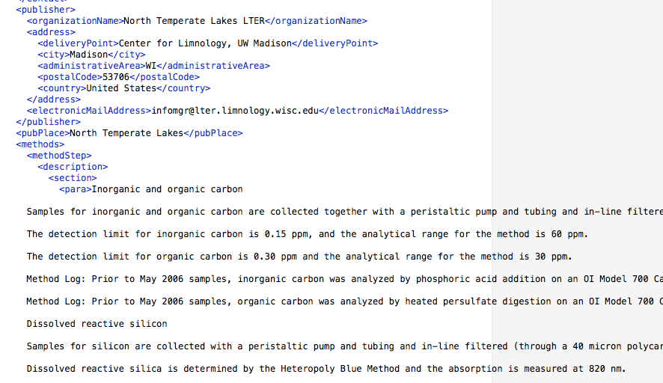
Semantic Metadata
Structured and explicit (machine readable)
Unstructured and not explicit (not machine readable)

Slide 16
Uses of Metadata
Facilitate reuse by others
Support queries on data repositories
Explain a data analysis by providing context for the data
Enable automated data integration

Slide 17
Metadata Vocabulary
A metadata vocabulary is the set of the terms used to describe metadata
“Average”
“Hourly Average”
“Population Average”
“Average Age”

Slide 18
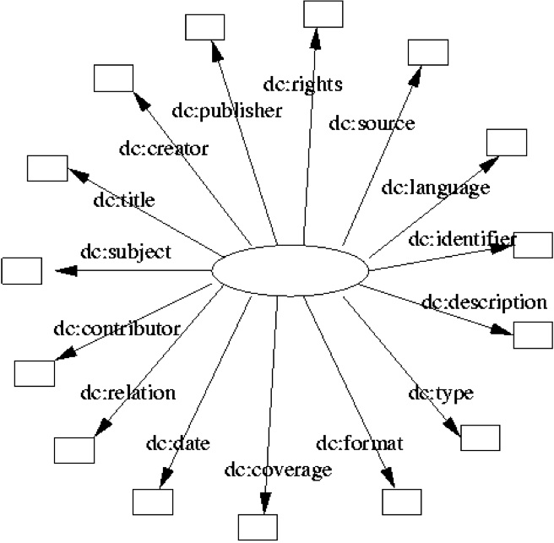
A Well-Known Metadata Vocabulary: The Dublin Core
From library sciences
http://dublincore.org/documents/dcmi-terms/
http://dublincore.org/documents/dcq-rdf-xml/

Slide 19
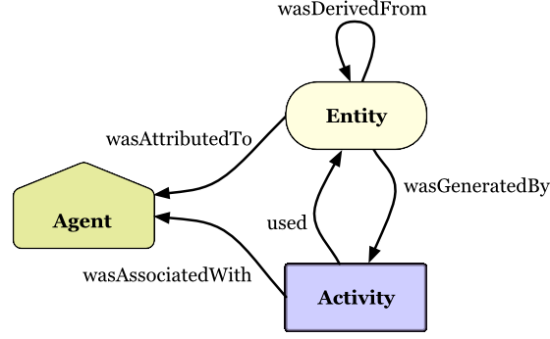
A Well-Known Provenance Vocabulary: PROV
actedOnBehalfOf
http://www.w3.org/TR/prov-primer/

Slide 20
Metadata Standard
A metadata standard is a vocabulary that is agreed upon by a community and are adopted for structured metadata
A vocabulary is designed based on its broad applicability and how well it supports uses of the metadata

Slide 21
Domain-Specific Metadata
Concert
National
Parks
Musicians
admission time
band
max elevation
singer
intermission time
campground
drummer
intermission duration
entrance
river

Slide 22
Domain-Independent Metadata
Events
Authorship
Geography
timepoint
name
affiliation
point
region
birthplace
interval
line
birthdate
year
location

Slide 23
A World of Metadata: From General to Specific
Events
Authorship
Geography
More
general
timepoint
name
affiliation
point
region
birthplace
interval
line
birthdate
birthdate
year
year
location
location
Concert
National
Parks
Musicians
More
specific
admission time
band
max elevation
singer
intermission time
campground
drummer
intermission duration
entrance
river

Slide 24
A World of Metadata: Interconnections
Events
Authorship
Geography
More
general
timepoint
name
affiliation
point
region
birthplace
interval
line
birthdate
year
location
Concert
National
Parks
Musicians
More
specific
admission time
band
max elevation
singer
intermission time
campground
drummer
intermission duration
entrance
river

Slide 25
Representing Metadata
Metadata captures knowledge about objects in the domain of interest
Sensors
People
Locations
Communications
Events
…
It is important to learn computational concepts for knowledge representation
These representations are key to communicate important expertise to collaborating data scientists and computer scientists

Slide 26
A Basic Introduction to Knowledge Representation

Slide 27
Knowledge Representation
Knowledge is a set of beliefs held by an agent that determine its behavior
I know two major events that took place in 1492
My cat knows where to find her food
Siri knows who won the Superbowl
Knowledge representation is a field of artificial intelligence devoted to developing and implementing computer languages to capture knowledge
AI, logic, philosophy, …

Slide 28
Meta-Knowledge
Knowledge
Meta-Knowledge
Objects
My car
Their properties
My car is blue
Events
I parked my car this morning
Abstract processes
Every Tuesday I drive to campus and teach a class
…
Uncertainty
I suspect B
I am confident that B
Attitude
He hopes that B
They regret that B
Intentions
I’d like to go to the beach, but I will study instead
…

Slide 29
Descriptive Knowledge
Our focus
Descriptive
Procedural
Classes (types) of objects
Bicycles, tricycles,…
Instances of those classes
My bicycle
Property types
Spouse, sibling (brother, sister)
Property values
All spouses are people
Constraints
Bicycles have 2 wheels
Abstractions
I’ll go to the airport (by car, bus, or taxi)
Sequences
First you wash, then you rinse
Complex orderings
Once you turn left on Sunset you may find parking on the left or on the right but don’t park in the street
Resources
To open the canister, use a sharp object

Slide 30
Knowledge Bases and Reasoning

Slide 31
Knowledge Base
Symbols are labels that can be used to refer to entities in the world
Several symbols may exist for the same object
7, VII
Beijing, Peking,
A knowledge representation language specifies
A notation for how to use symbols to represent beliefs
An algorithm and associated rules for how to use symbols to do reasoning
An example of a knowledge representation language is first-order logic
A knowledge base is a set of beliefs expressed in a knowledge representation language and used by a system to generate its behavior

Slide 32
Knowledge Systems
Knowledge systems contain a knowledge base of beliefs that is used to generate their behavior
Their behavior changes when new beliefs are added
If they exhibit wrong behaviors, beliefs can be changed to fix them
They can generate an explanation (or proof) about how their behavior results from using logical inference over their beliefs

Slide 33
Reasoning
Reasoning is done over symbols much like calculations are done over numbers
Reasoning uses a logic system to do inference: a system of general logic rules to deduce new beliefs from initial beliefs in a knowledge base
Natural deduction is an example of a logic system
“modus ponens” is a rule in natural deduction
If I believe that “if A then B”, and A is true, then I can deduce that B must be true

Slide 34
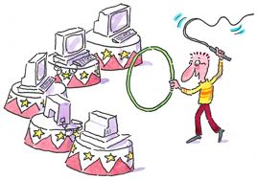
Knowledge Representation
number
55 miles
measurement
value
unit
distance-
value
distance-unit
55
55-mile
mile

Slide 35
Knowledge Representation System
Three components:
Knowledge representation language: what symbols can be used and how to combine them so the system understands
Logic rules: how can the system infer new things given what it is told
Reasoning algorithm: how will the system use the symbols and the logic rules

Slide 36
Representing Descriptive Knowledge: Common Expressions Needed
Types
Faculty, staff, students
Subtypes
Student: graduate, undergraduate
Disjointness
Student vs faculty
Exhaustiveness
University student: graduate, undergraduate, post-graduate
Inverses
Advisor/advisee
Symmetry
Classmate
Restrictions/constraints
Students must be registered for courses
Definitions
Engineering students are those that declare Engineering as their major

Slide 37
Frame Systems

Slide 38
Frame Systems: Representation
Individual frames: represent specific objects or entities
Paul, George, John, Ringo, The Beatles
Generic frames: represent categories or classes of individuals
Person, Musician, Band
Slots: represent properties that are attached to a frame
Bands have members
Values: represent fillers of a frame’s slots, which can be other frames
The members of The Beatles were Peter, George, John, and Ringo

Slide 39
An Example Frame System: Formal Language (I)
Bracket notation
is-a
instance-of
[George instance-of Musician]
[Ringo instance-of Musician]
[John instance-of Musician]
[Paul instance-of Musician]
[Yoko instance-of Person]
[Person
[age Number]
[birthplace Location]
]
[Musician
[is-a Person]
]
[Band
[member Musician]
[debutYear Year]
[groupie Person]
]
[TheBeatles
[instance-of Band]
[member Paul]
[member George]
[member Ringo]
[member John]
[groupie Yoko]
]

Slide 40
An Example Frame System: Formal Language (II)
Multiple parents
[John instance-of Musician]
[John instance-of Songwriter]
[Songwriter
[is-a Person]
]

Slide 41
An Example Frame System: Logic Rules (I)
Inheritance from parent classes
(Multiple inheritance)
[John instance-of Musician]
[John instance-of Songwriter]
[John instance-of Guitarist]
[Songwriter
[is-a Person]
]
[Guitarist
[is-a Musician]
[plays Guitar]
]
Is [John plays Guitar] true?
Yes, inherited by the frame John from its parent frame Guitarist

Slide 42
An Example Frame System: Logic Rules (II)
Classification: organizing generic frames according to generalization/specialization
[Songwriter
[is-a Person]
]
[Musician
[is-a Person]
]
[Guitarist
[is-a Musician]
[plays Guitar]
]
[Singer
[is-a Musician]
Is [Singer is-a Person] true?
Yes, by classification of the frame Singer as an specialization of the generic frame Person

Slide 43
An Example Frame System: Logic Rules (III)
Recognition: whether a new individual frame is an instance of a generic frame
[Songwriter
[is-a Person]
]
[Guitarist
[is-a Musician]
[plays Guitar]
]
[Bruce instance-of Musician]
[Bruce plays Guitar]
Is [Bruce instance-of Guitarist] true?
Yes, by recognition of the frame Bruce as an instance of the generic frame Guitarist

Slide 44
An Example Frame System: Logic Rules (IV)
Mark Yoko as inconsistent? Or assume Yoko to be a Musician?
[George instance-of Musician]
[Ringo instance-of Musician]
[John instance-of Musician]
[Paul instance-of Musician]
[Yoko instance-of Person]
[Person
[age Number]
[birthplace Location]
]
[Musician
[is-a Person]
]
[Band
[member Musician]
[debutYear Year]
[groupie Person]
]
[TheBeatles
[instance-of Band]
[member Paul]
[member George]
[member Ringo]
[member John]
[groupie Yoko]
[member Yoko]
]

Slide 45
An Example Frame System: Reasoning Algorithm
Algorithm:
Classify generic frames
If inconsistency is detected, return “Inconsistent”
If belief B is in KB then return Yes, otherwise continue
Recognize individual frames
If inconsistency is detected, return “Inconsistent”
If belief B is in KB then return Yes, otherwise continue
Inherit slot values for all frames
If inconsistency is detected, return “Inconsistent”
If belief B is in KB then return Yes, otherwise continue
Given:
A knowledge base KB of generic frames and individual frames
A question about a belief B about frame F
Output: Yes/No

Slide 46
Logic Systems: Summary
To describe a frame system as a logic system we had to specify:
A formal language
is-a, instance-of, etc
Logic rules
Inheritance, classification, etc.
Decide whether to flag inconsistencies or make assumptions
Etc.
A reasoning algorithm
Important characteristics of a logic system:
Expressivity
What its formal language can represent
Soundness
The logic works as intended
Decidability
Undecidable if it may never return an answer
Computational complexity
How much computation is required to get an answer
Explainability
Can an understandable proof/explanation be generated

Slide 47
Examples of Frame Systems

Slide 48
A More Complex Frame System: More Logic Rules
IF-ADDED: slot computed immediately
IF-NEEDED: slot computed if asked
[Person
[age Number]
[birthplace Location]
]
[Musician
[is-a Person]
]
[Band
[member Musician]
[debutYear Year]
[groupie Person]
[age
IF-ADDED[offset(debutYear)]]
[size
IF-NEEDED[count(enumerate(member))]]
]
[George instance-of Musician]
[Ringo instance-of Musician]
[John instance-of Musician]
[Paul instance-of Musician]
[Yoko instance-of Person]
[TheBeatles
[instance-of Band]
[member Paul]
[member George]
[member Ringo]
[member John]
[groupie Yoko]
]

Slide 49
A More Expressive Frame System: An Extended Language
Constraints on slots
Rules
[PopularBand
[is-a Band]
[debutYear Year]
[exists 1 groupie]
]
[Musician
[is-a Person]
]
[Guitarist
[is-a Musician]
[plays Guitar]
]
[Band
[member at-least 2 Musician]
[member [one-of Guitarist Vocalist …]
[debutYear Year]
[groupie Person]
]
[If [and [B instance-of Band]
[B member M]
[P married-to M]]
Then [B groupie P]
]

Slide 50
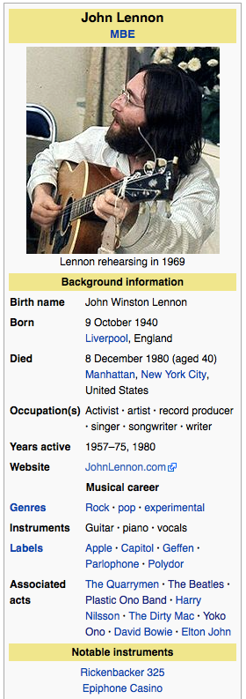

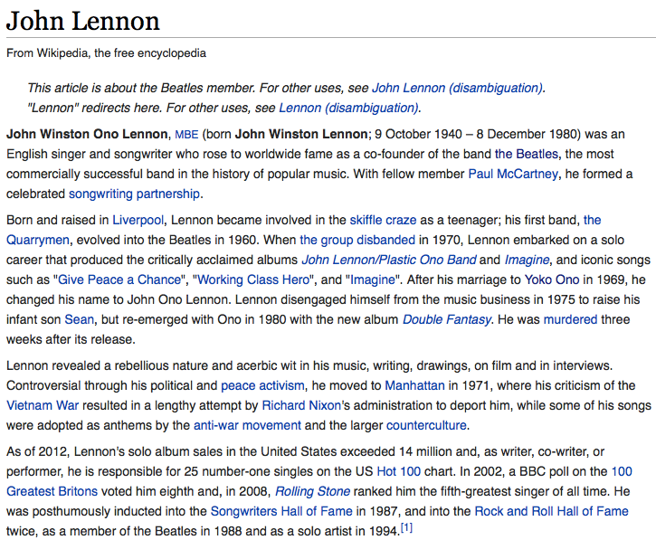
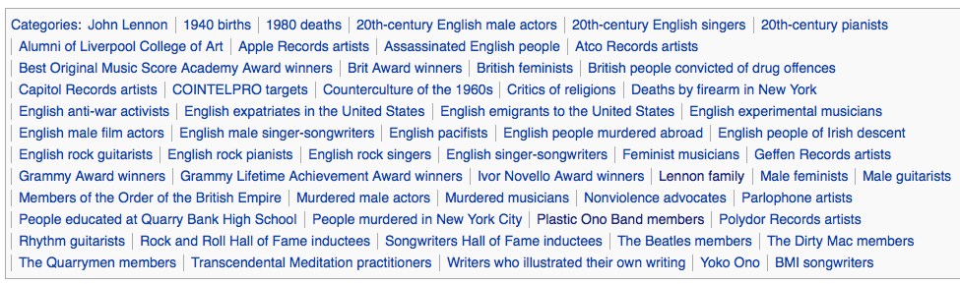
A Simpler Frame System: Wikipedia’s Categories and Infoboxes

Slide 51
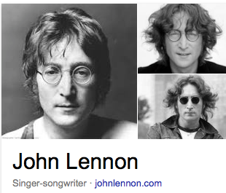
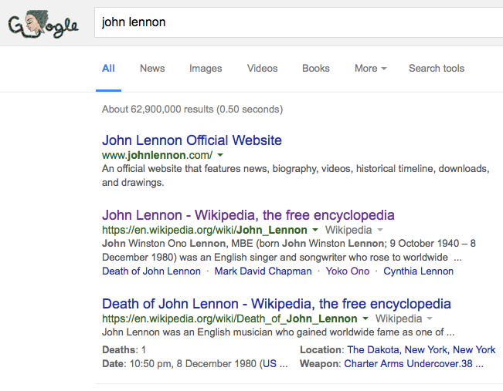
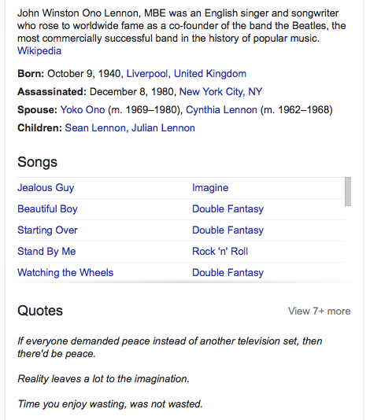
A Simpler Frame System: The Google Knowledge Graph

Slide 52
Representing Metadata

Slide 53
Representing Metadata
Metadata usually descriptive knowledge about objects and their properties and can be represented in a frame language
A playlist: metadata about songs
A timeseries: metadata about timestamps and variables
A phone company: metadata about call time and duration
Twitter: metadata about followers
Beyond metadata, knowledge representation languages can be used to describe formally a domain
Source of useful features for machine learning

Slide 54
Knowledge Representation System
Three components:
Knowledge representation language: what symbols can be used and how to combine them so the system understands
Logic rules: how can the system infer new things given what it is told
Reasoning algorithm: how will the system use the symbols and the logic rules

Slide 55
Challenges
Knowledge Bases
Logic System
Can be:
Incomplete
Are missing some fact
Inaccurate
Contains false beliefs
Inconsistent
Contain mutually exclusive beliefs
Can be:
Undecidable
Cannot guarantee to generate a yes/no answer to a question through logic inference
Computationally complex
Time to get an answer as a function of the size of the knowledge base
e.g., O(2^{n})

Slide 56
Semantic Metadata
Metadata
A basic introduction to knowledge representation
Knowledge bases and reasoning
Frame systems
Examples of frame systems
Representing metadata

Slide 57
Ontologies and the OWL
Web Ontology Language
Introduction to Computational Thinking and Data Science
Yolanda Gil
gil@isi.edu
Fall 2016

Slide 58
Ontologies
The expressivity/complexity tradeoff
OWL: The Web Ontology Language
Classes in OWL
Properties
Class definitions
Logic rules
Reasoning algorithm
Dialects of OWL
<Class exercise>
Designing an ontology

Slide 59
Expressivity/Complexity Tradeoffs

Slide 60
Challenges of Using Knowledge Systems
Knowledge Bases
Logic System
Can be:
Incomplete
Are missing some fact
Inaccurate
Contains false beliefs
Inconsistent
Contain mutually exclusive beliefs
Can be:
Undecidable
Cannot guarantee to generate a yes/no answer to a question through logic inference
Computationally complex
Time to get an answer as a function of the size of the knowledge base
e.g., O(2^{n})

Slide 61
Representing Descriptive Knowledge: Common Expressions Needed
Types
Faculty, staff, students
Subtypes
Student: graduate, undergraduate
Disjointness
Student vs faculty
Exhaustiveness
University student: graduate, undergraduate, post-graduate
Inverses
Advisor/advisee
Symmetry
Classmate
Restrictions/constraints
Students must be registered for courses
Definitions
Engineering students are those that declare Engineering as their major

Slide 62
Ontologies
An ontology is a shared conceptualization of the world containing descriptive knowledge
More information than just a vocabulary (ie a collection of terms)
Ontology refers to generic frames, not individual frames
Thought the distinctions are hard to make sometimes
Eg is a “Prius” a generic frame or an individual frame?
Ontologies are more expressive than frame systems

Slide 63
OWL: The Web Ontology Language

Slide 64
OWL Topics
OWL overview
Representing knowledge in OWL
Classes in OWL
Properties
Class definitions
Logic rules
Reasoning algorithm
Dialects of OWL

Slide 65
OWL: The Web Ontology Language
A standard language for the web (like HTML)
Logic system: a description logic
Represents descriptive knowledge (ie, about objects)
A more elaborate version of a frame system
As with any logic system, we will study
The language
The rules
The reasoning algorithm
There are actually 3 versions (“species”) of it with different expressivity and complexity

Slide 66
OWL Classes

Slide 67
Root Classes
Root classes are major categories of objects
A root class is a subclass of “Thing”
Musician subClassOf Thing .
MusicalGroup subClassOf Thing .
Instrument subClassOf Thing .

Slide 68
Parent/Sibling Classes
Sibling classes share the same parent class
“Thing” has no parents
Musician subClassOf Thing .
MusicalGroup subClassOf Thing .
Instrument subClassOf Thing .

Slide 69
Disjoint Classes
Make classes disjoint if instances cannot belong to more than one sibling class
Consider specifying sets of sibling classes that are disjoint
Musician subClassOf Thing .
MusicalGroup subClassOf Thing .
Instrument subClassOf Thing
Person subClassOf Thing .
DisjointSubClasses
Musician
MusicalGroup
Instrument .

Slide 70
Class Hierarchies
Create classes for terms/categories that you use to describe objects, and relate them to one another
Instrument subClassOf Thing .
WindInstrument subClassOf Instrument .
StringInstrument subClassOf Instrument .
Voice subClassOf Instrument .
PercussionInstrument subClassOf Instrument .
Piano subClassOf KeyboardInstrument .
Saxophone subClassOf WindInstrument .
Bassoon subClassOf WindInstrument .
Trumpet subClassOf WindInstrument .
Violin subClassOf StringInstrument .
Cello subClassOf StringInstrument .
ElectricGuitar subClassOf StringInstrument.
What about electric instruments?
Alto subClassOf Voice .
Tenor subClassOf Voice .
Bass subClassOf Voice .
DrumSet subClassOf PercussionInstrument .
Piano subClassOf KeyboardInstrument .

Slide 71
Multiple Class Hierarchies (Multiple Parent Classes)
Instrument subClassOf Thing .
WindInstrument subClassOf Instrument .
StringInstrument subClassOf Instrument .
Voice subClassOf Instrument .
PercussionInstrument subClassOf Instrument .
Accordion subClassOf Instrument .
Saxophone subClassOf WindInstrument .
Bassoon subClassOf WindInstrument .
Trumpet subClassOf WindInstrument .
Violin subClassOf StringInstrument .
Cello subClassOf StringInstrument .
ElectricGuitar subClassOf StringInstrument .
ElectricInstrument subClassOf Instrument .
Alto subClassOf Voice .
Tenor subClassOf Voice .
Bass subClassOf Voice .
Keyboard subClassOf ElectricInstrument .
ElectricGuitar subClassOf ElectricInstrument .
DrumSet subClassOf PercussionInstrument .
What about a percussion string instrument?
Piano subClassOf KeyboardInstrument.

Slide 72
Disjoint Classes (but only for some sibling classes)
Instrument subClassOf Thing .
WindInstrument subClassOf Instrument .
StringInstrument subClassOf Instrument .
Voice subClassOf Instrument .
PercussionInstrument subClassOf Instrument .
KeyboardInstrument subClassOf Instrument .
Saxophone subClassOf WindInstrument .
Bassoon subClassOf WindInstrument .
Trumpet subClassOf WindInstrument .
Violin subClassOf StringInstrument .
Cello subClassOf StringInstrument .
ElectricGuitar subClassOf StringInstrument .
ElectricInstrument subClassOf Instrument .
Alto subClassOf Voice .
Tenor subClassOf Voice .
Bass subClassOf Voice .
Keyboard subClassOf ElectricInstrument .
ElectricGuitar subClassOf ElectricInstrument .
DisjointClasses WindInstrument
StringInstrument Voice
PercussionInstrument .
DrumSet subClassOf PercussionInstrument .
Piano subClassOf KeyboardInstrument.

Slide 73
OWL Properties

Slide 74
Instances
Instances are the objects in a class
Instances can belong to more than one class
Beatles type MusicalGroup .
Beatles type PopularCulture.

Slide 75
Properties
Properties represent relations between entities
Properties can be organized into classes
MusicalGroup hasMember Musician .
MusicalGroup hasManager Manager .
Musician playsInstrument Instrument .
playsViolin subPropertyOf playsInstrument .

Slide 76
Datatypes
Special classes for very common kinds of data
Already defined in the system
Include: String, Integer, PositiveInteger, NonNegativeInteger, Decimal, Date, DateTime,…
MusicalGroup ensembleSize positiveInteger.
Beatles ensembleSize 4.

Slide 77
Property Domains and Ranges
Property domain: the class that the property applies to
Property range: the class of the property’s values
hasMember
domain MusicalGroup ;
range Musician .

Slide 78
Property Constraints (I)
Inverse, disjoint, reflexive, symmetric,…
hasManager inverseOf manages .
hasManager propertyDisjointWith hasMember .
x type ReflexiveProperty .
x type SymmetricProperty .
x type AsymmetricProperty .

Slide 79
Property Constraints (II)
Cardinality constraints on the amount of property values
Quartet type [
type Restriction ;
cardinality 4 ;
onProperty hasMember
] .

Slide 80
Property Constraints (III)
Constraints on the types of property values
someValuesFrom: at least one value is from the given range
allValuesFrom: if there are any values, they are from the given range
SymphonyOrchestra type Class ;
equivalentClass [
type Restriction ;
hasMember someValuesFrom StringInstrumentPlayer;
] .
StringEnsemble type Class ;
equivalentClass [
type Restriction;
hasMember allValuesFrom StringInstrumentPlayers ;
] .

Slide 81
OWL: Class Definitions

Slide 82
Class Definitions
Any instance of the class satisfies the definition
Any instance that satisfies the definition is in the class
Is this a good definition?
Band equivalentClass [
type Restriction ;
hasMember someValuesFrom Musician;
hasManager someValuesFrom Manager;
] .

Slide 83
Class Definitions
Any instance of the class satisfies the definition
Any instance that satisfies the definition is in the class
Is this a good definition?
Band equivalentClass [
type Restriction ;
hasMember someValuesFrom Musician;
hasManager someValuesFrom Manager;
] .
No, because this allows a non-”Manager” to be a manager of a band.

Slide 84
Class Definitions
Any instance of the class satisfies the definition
Any instance that satisfies the definition is in the class
This is a good definition:
Band equivalentClass [
type Restriction ;
hasMemeber someValuesFrom Musician;
hasManager allValuesFrom Manager;
hasMemeber allValuesFrom (Musician Groupie) ;
] .
A band with only musicians and groupies as members and managers as managers satisfies this.

Slide 85
Class Definitions (Cont’d)
Can have property definitions using the same constructs
NonWindInstrumentPlayer equivalentClass
[ intersectionOf
( [complementOf WindInstrumentPlayer]
InstrumentPlayer ) ] .
locatedIn
a TransitiveProperty , ObjectProperty ;
inverseOf locationOf.

Slide 86
Class Unions
All individuals are in at least one of the classes
The classes do not have to be disjoint
Quartet equivalentClass [
type Class ;
unionOf ( StringQuartet WindQuartet BarbershopQuartet )
] .

Slide 87
Class Intersections
All individuals are in both classes
ElectricGuitarist equivalentClass [
type Class
intersectionOf ( ElectricInstrumentPlayer Guitarist)
] .

Slide 88
Description Logics
Description logics are logic systems that allow classes to have descriptions, and the reasoning algorithm uses those descriptions to do classification and recognition
Classification: detect that a class is a subclass of another
Recognition: detect that an instance belongs to a class
All instances of a subclass are also instances of the parent class
OWL is a description logic

Slide 89
OWL: Logic Rules

Slide 90
OWL: Logic Rules
Inheritance, multiple inheritance
Classification, given class definitions
Recognition of instances, given class definitions and instance properties
Assume whatever is needed to make things consistent
<And one more thing….>

Slide 91
Determining Truth in a Knowledge Base
In a database, all is thoroughly listed
E.g., all students
E.g., all employees
We assume that if not listed, it is not included
E.g., an person not listed is not a student
In a knowledge base, things may not be listed because it is expected that they will be inferred
E.g., “groupies of a band are persons that attend more than 3 concerts”
Julie has attended 4 concerts of ColdPlay
So if something is not listed, we cannot assume it is not included

Slide 92
Closed- and Open-World Reasoning
Paul member TheBeatles ;
John member TheBeatles ;
Ringo member TheBeatles ;
George member TheBeatles ;
Yoko groupie TheBeatles ;
Is this true:
Obama groupie TheBeatles
Paul member TheBeatles ;
John member TheBeatles ;
Ringo member TheBeatles ;
George member TheBeatles ;
Yoko groupie TheBeatles ;
Closed-World
Open-World
If B is in the KB, then the answer is “true”
If not B is in the KB, then the answer is “false”
If nothing is known about B, then the answer is “false”
If B is in the KB, then the answer is “true”
If not B is in the KB, then the answer is “false”
If nothing is known about B, then the answer is “unknown”
Databases
OWL

Slide 93
OWL: Logic Rules
Inheritance, multiple inheritance
Classification, given class definitions
Recognition of instances, given class definitions and instance properties
Assume whatever is needed to make things consistent
Open-world assumption

Slide 94
OWL: Reasoning Algorithm

Slide 95
OWL Reasoning Algorithm
Very complicated, we will not cover it
The more advanced constructs in the language, the more complicated the algorithm is
Higher computational complexity as well
OWL has several versions of the language with different tradeoffs in expressivity/complexity

Slide 96
Dialects of OWL

Slide 97
The Three Original Dialects of OWL
OWL DL
Expressivity of description logics: boolean combinations of class restrictions, disjointness, union, intersection
Decidable (it will give an answer)
OWL Lite
A subset of OWL DL: class hierarchy, a few constraints (atLeast, atMost, exactly 1 or 0)
OWL Full
Most expressive: classes can be instances, arbitrary cardinality
Undecidable
Other dialects: OWL EL, OWL QL, OWL RL

Slide 98
Class Exercise

Slide 99
Running Example: Describing Pizzas
Crust
thickness
wheat vs gluten-free
Toppings
meats, veggies,…
Cheeses
mozzarella, parmesan,…
Classic pizzas
Margherita, meat lovers,…
Classes vs instances
Is “pepperoni” an instance? Or a class?
Properties
A pizza has toppings, but is cheese a topping or a separate property?
Class definitions
What makes a pizza a pizza?
Multiple views
Topping food type (veggie, meat)
Topping spiciness
Philosophical matters
Is a topping-less pizza a pizza?

Slide 100
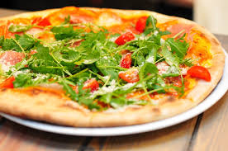
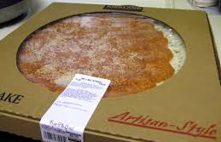
Class Exercise
Classes vs instances
Is “pepperoni” an instance? Or a class?
Properties
A pizza has toppings, but is cheese a topping or a separate property?
Class definitions
What makes a pizza a pizza?
Multiple views
Topping food type (veggie, meat)
Topping spiciness
Philosophical matters
Is a topping-less pizza a pizza?
Assume you work for a business, and would like to represent pizzas so you can bill customers
A phone-order pizza business
A self-service restaurant
A fancy restaurant
A supermarket
Your task is to create some frames for: crust, toppings, cheeses, and classic pizzas

Slide 101
Take Aways from Exercise: Ontology Design
Purpose and uses
Scope
Granularity
Modeling decisions

Slide 102
Designing An Ontology
Collect typical queries that will be asked of a KB
Identify the objects in the queries and the answers
Create beliefs that describe the objects/properties in those queries
Each of those objects should have a corresponding class
Discern what properties are common to sets of objects, that may be a candidate for a class
Question types: The 5 Ws
Who
What
Where
When
How

Slide 103
Ontologies
The expressivity/complexity tradeoff
OWL: The Web Ontology Language
Classes in OWL
Properties
Class definitions
Logic rules
Reasoning algorithm
Dialects of OWL
<Class exercise>
Designing an ontology

Slide 104
III. The Semantic Web
Introduction to Computational Thinking and Data Science
Yolanda Gil
gil@isi.edu
Fall 2016

Slide 105
The Semantic Web
Example: biomedical knowledge on the Web
Distributed ontologies on the Web
RDF
Finding Ontologies on the Web
Linked Data on the Web

Slide 106
Why Distributed Ontologies: Biomedical Knowledge on the Web

Slide 107




In the Beginning (circa 1998)
GenBank

Slide 108
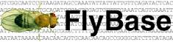



The Gene Ontology (GO) http://www.geneontology.org/
Three Organisms
Three Focus Areas
Cellular component
Biological process
Molecular function

Slide 109
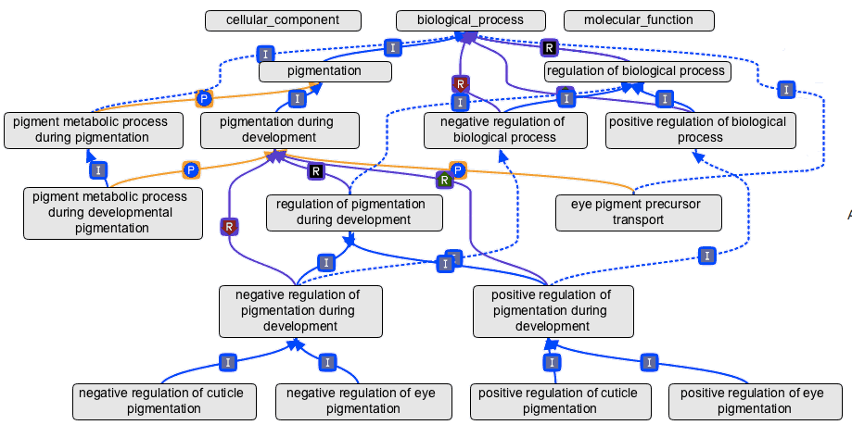
Concepts and the Relationships Among Them

Slide 110
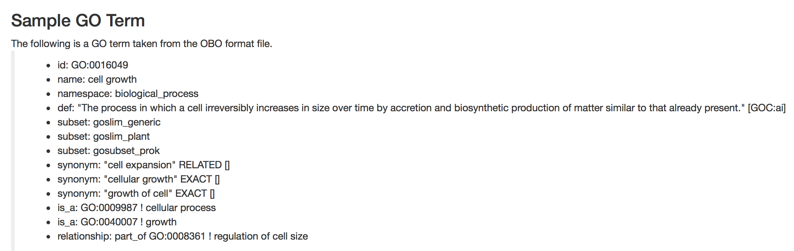
Sample GO Term http://geneontology.org/page/ontology-documentation

Slide 111
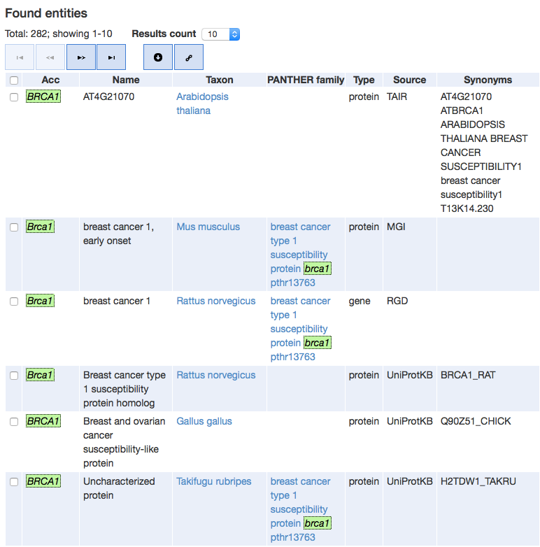
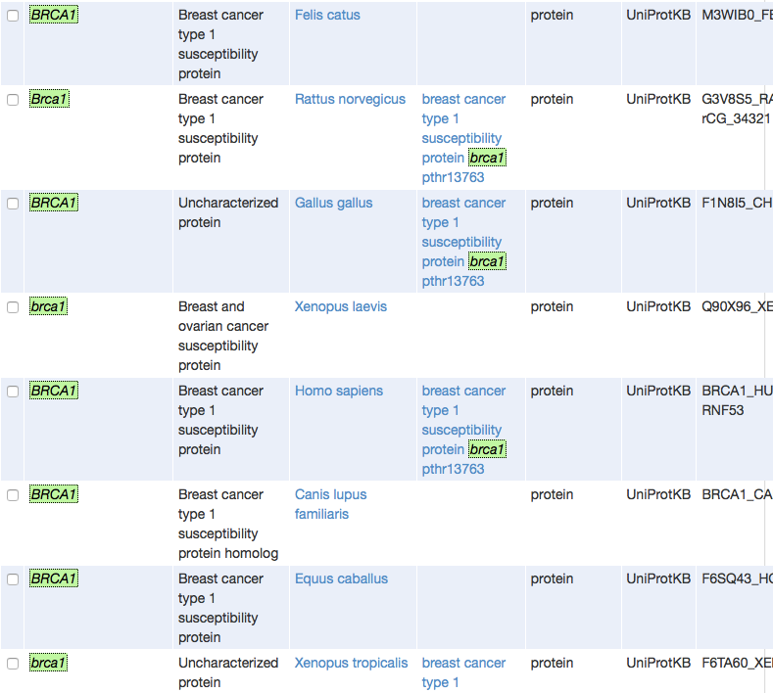

Slide 112
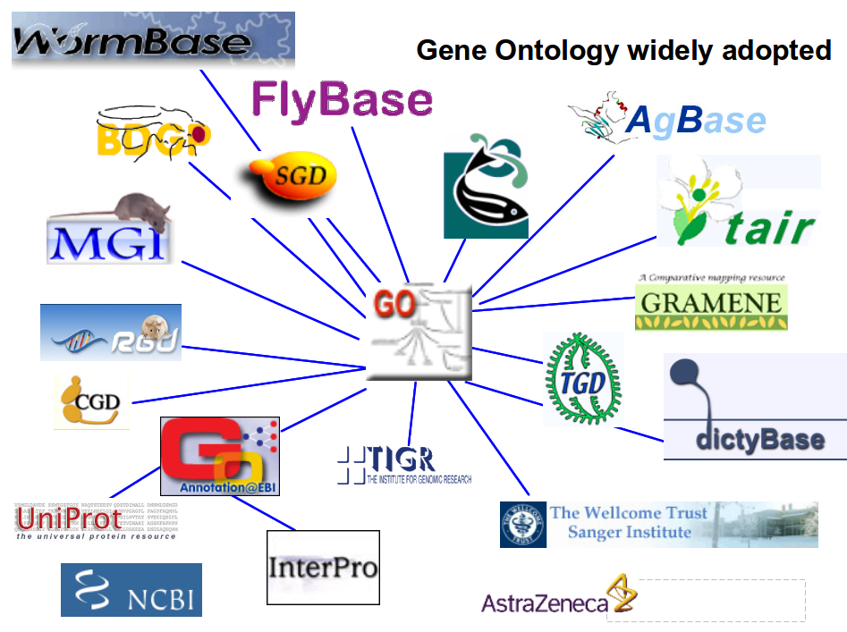

Slide 113
Concepts and the Relationships Among Them

Slide 114
Distributed Ontologies on the Web

Slide 115
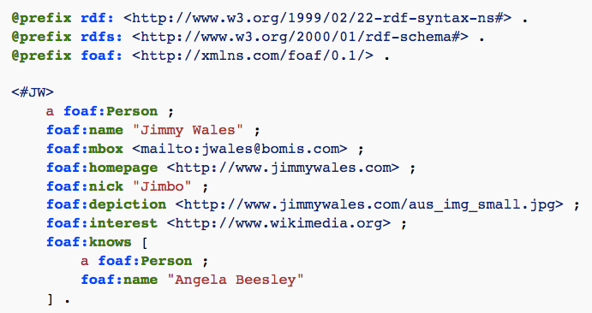
Ontologies On the Web: Friend of a Friend (FOAF)
namespace
https://en.wikipedia.org/wiki/FOAF_(ontology)

Slide 116
Linking Ontologies 1) Through URLs/URIs
@prefix : <http://www.usc.edu/people#> .
@prefix foaf: <http://www.w3.org/2012/foaf#> .
@prefix time: <http://www.w3.org/2009/time#> .
@prefix rdf: <http://www.w3.org/1999/02/22-rdf-syntax-ns#> .
@prefix owl: <http://www.w3.org/2002/07/owl#> .
:faculty rdfs:subClassOf foaf:Person .
:student rdfs:subClassOf foaf:Person .
:graduation rdfs:subclassOf time:event.
namespace

Slide 117
Linking Ontologies 2) Mapping Terms
In owl:
sameAs
yale:professor owl:sameAs usc:faculty .
Using the SKOS standard vocabulary
broader
narrower
related

Slide 118
RDF

Slide 119
RDF: The Resource Description Framework
Simple logic language where beliefs are triples:
<object property value>
Examples:
<Leonardo painted LaMonaLisa>
<Shakespeare wrote Hamlet>
<Bon isInterestedIn LaMonaLisa>

Slide 120
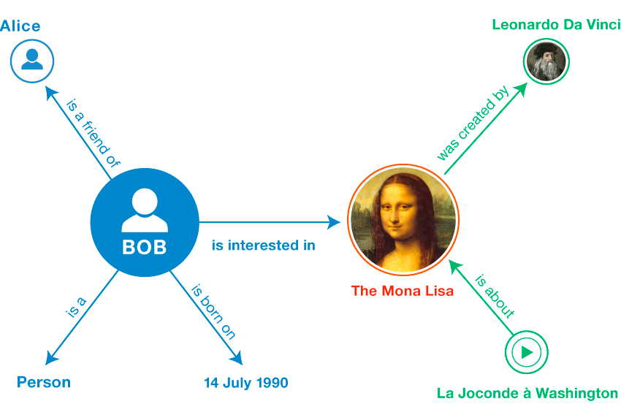
http://www.w3.org/TR/2014/NOTE-rdf11-primer-20140624/

Slide 121
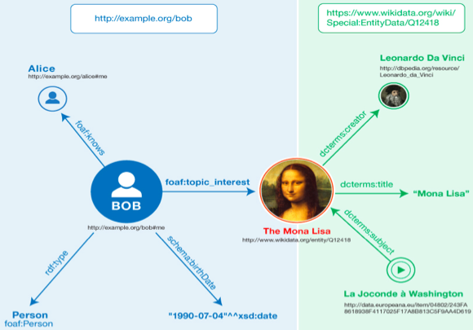


Giving Meanings to Hyperlinks on the Web
http://www.w3.org/TR/2014/NOTE-rdf11-primer-20140624/

Slide 122
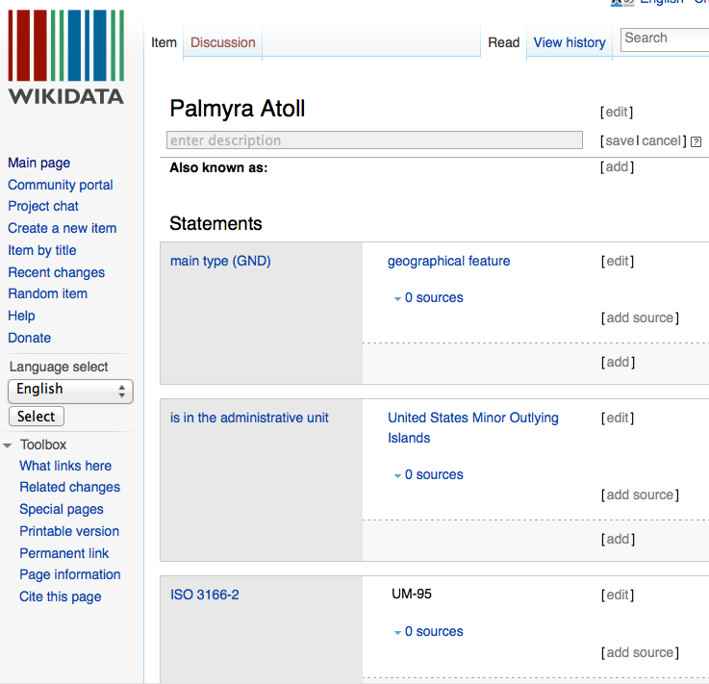
Wikidata [Vrandecic et al @ WikiMedia Foundation 2012]

Slide 123
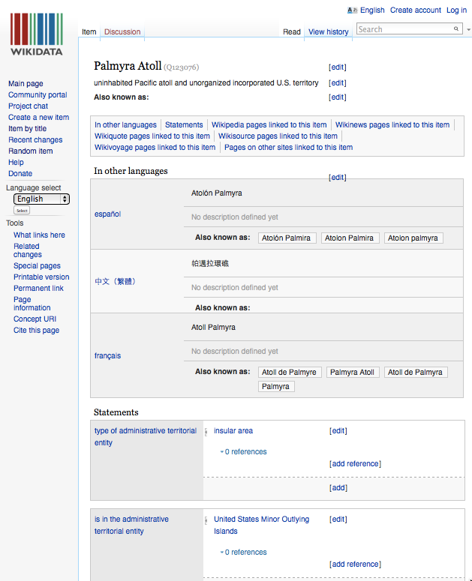
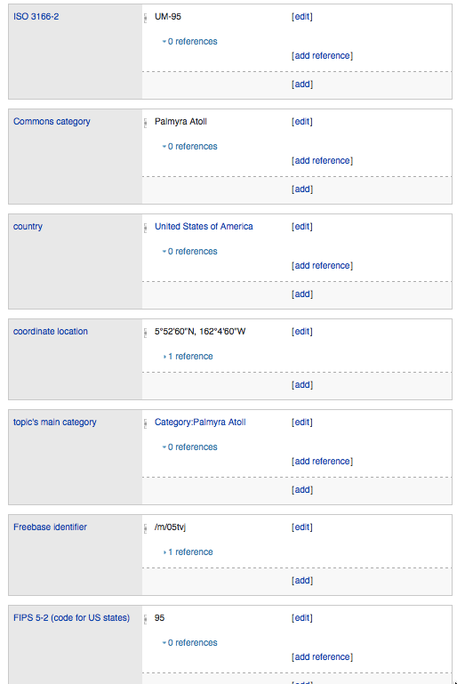
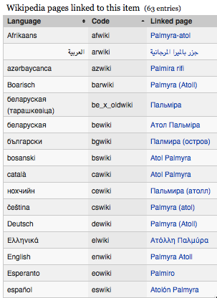
Wikidata [Vrandečić and Krötzsch, CACM 2014]
http://www.wikidata.org/wiki/Q123076

Slide 124
Finding Ontologies on the Web

Slide 125
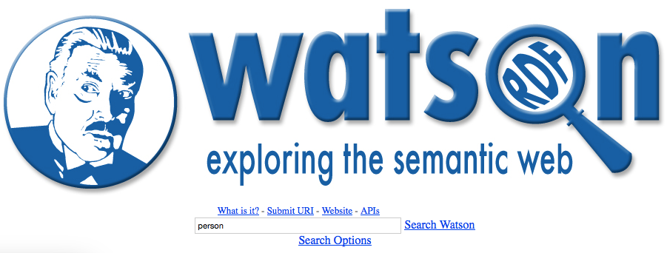
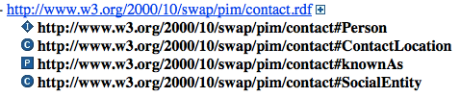
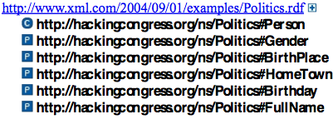
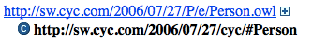
Finding Ontologies on the Web: Semantic Search Engines http://watson.kmi.open.ac.uk/WatsonWUI/

Slide 126




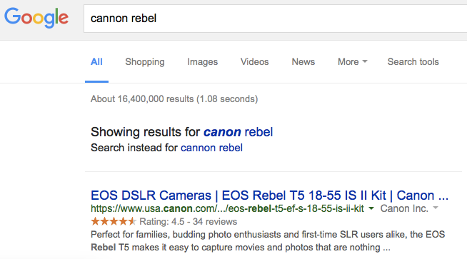
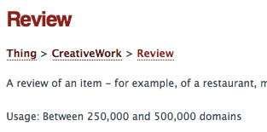
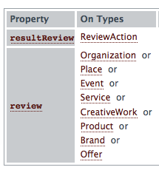
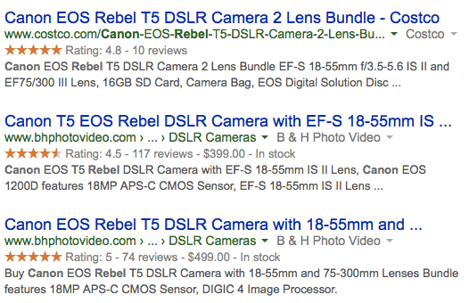
Popular Ontologies: schema.org

Slide 127
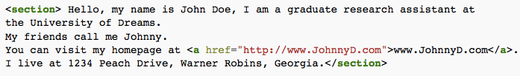
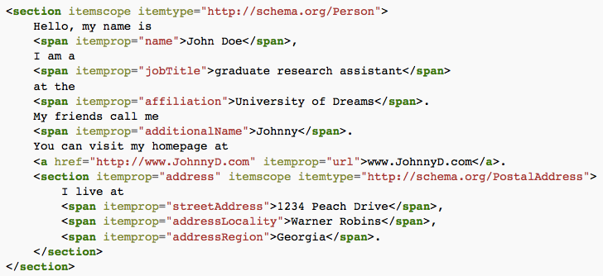
Microdata
Microdata is markup added to HTML files that search engines use

Slide 128
Ontologies vs Taxonomies vs Vocabularies
Vocabularies: a set of terms
Taxonomies: a hierarchical organization of terms
Ontologies: formal taxonomies with logic constraints
Mathematical logic provides formal semantics for what the hierarchies mean
Subclasses imply containment of instances
Instances of a class have all the properties of the class
Logic constraints
Example: all humans have exactly one biological mother

Slide 129
Linked Data: Beliefs on the Web

Slide 130
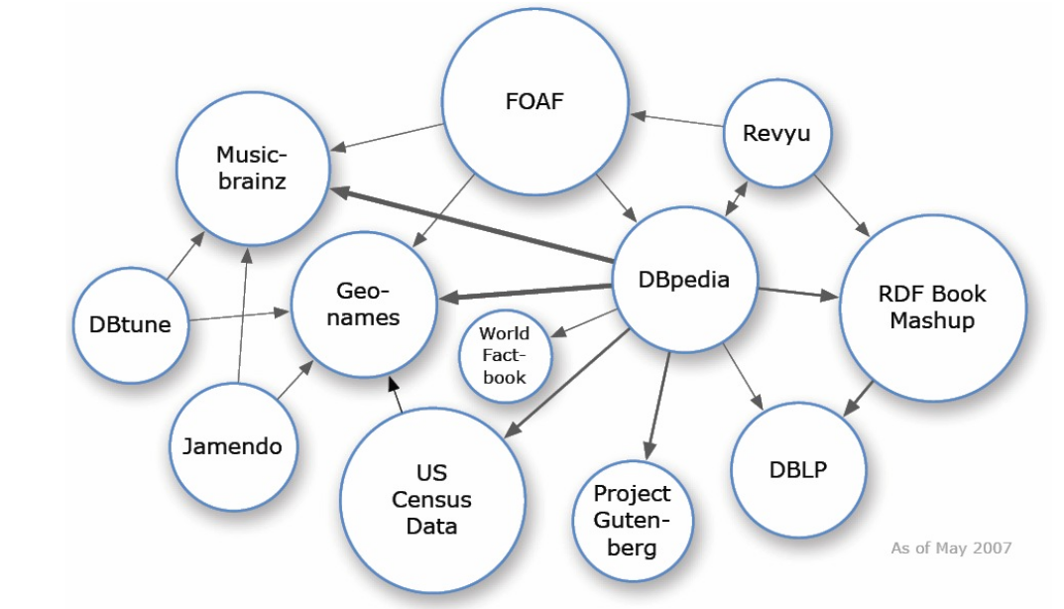
Connecting Data on the Web

Slide 131
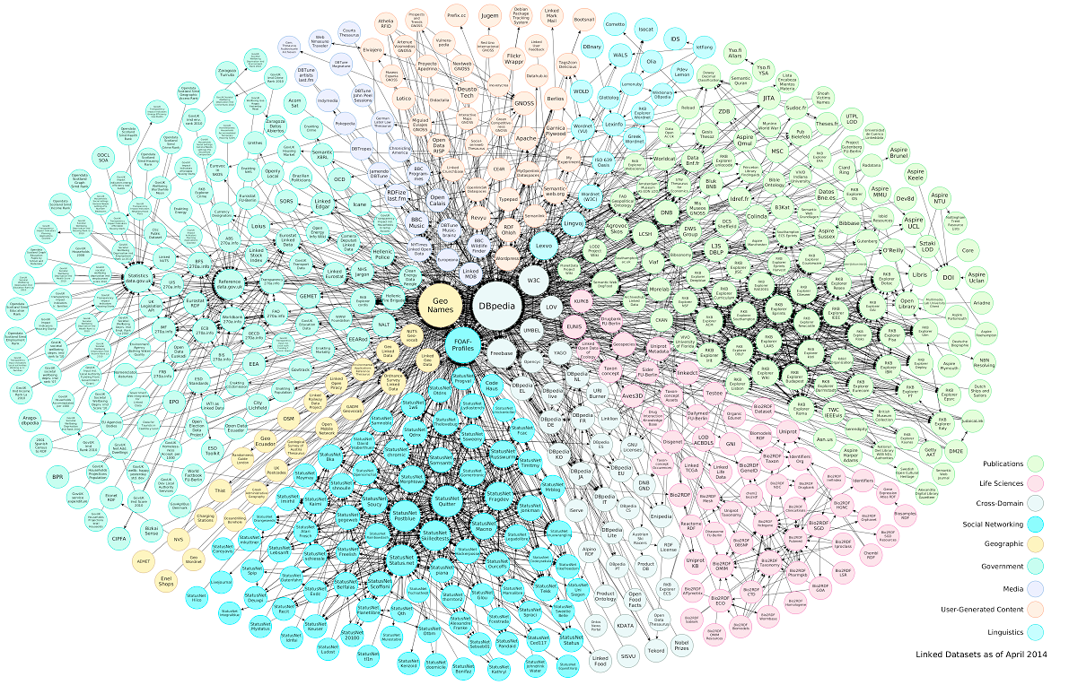
Interlinked Data and Ontologies on the Web
"Linking Open Data cloud diagram 2014, by Max Schmachtenberg, Christian Bizer, Anja Jentzsch and Richard Cyganiak. http://lod-cloud.net/"

Slide 132








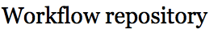




LinkedEarth: A Project Using Linked Data
Estimate
Age of
Water
Isotopes
Oxygen -16
Springflow
levels
Quelccaya
Ice Cap
Vegetation
Estimates
PROV
Quelccaya
20C
Neotoma
Physical
sample
Ice
Core
Navier-Stokes

Slide 133











Interlinked Data and Ontologies on the Web
 | 2007 | 2011 | 2015
Datasets | 294 | 571 | 3426
Triples | 2B | 31B | 85B
Cross-refs | 2M | 500M
74% of datasets in a weakly
connected component
FOAF: from 27% to 59%
DC: from 31% to 56%
http://lod-cloud.net
http://stats.lod2.eu

Slide 134
The Semantic Web
Example: biomedical knowledge on the Web
Distributed ontologies on the Web
RDF
Finding Ontologies on the Web
Linked Data on the Web

Slide 135
Metadata Topics
Semantic metadata
Ontologies
The Semantic Web

